Slide 1
Case study research
2023
5 December 2023

Slide 2
Learning objectives
Decide whether a case study is a suitable method, given a research question
List good practices in case research
Specify the four elements of a case study protocol for a research topic
Explain core choices within each element of the case study protocol

Slide 3
What are case studies? (1)
Empirical, in-depth study of contemporary phenomenon (“the case”) within its real-life context
No clear boundaries between phenomenon and context
Yin 2003; Yin 2018

Slide 4
What are case studies? (2)
Distinctive situation with many more variables of interest than data points
Benefits from prior development of theoretical propositions to guide data collection and analysis
Relies on multiple sources of evidence, with data that needs to be triangulated
Yin 2003; Yin 2018

Slide 5
What are case studies? (3)
All-encompassing mode of inquiry
specific design logic, data collection techniques, and data analysis approaches
Note: case studies ≠ Qualitative research
Commonly made mistake!
Notes:
In essence, the twofold definition—covering the scope and features of a case study—shows how case study research comprises an all-encompassing mode of inquiry, with its own logic of design, data collection techniques, and specific approaches to data analysis.
Case studies ≠ Qualitative research
And yes, case studies can include, and even be limited to, quantitative evidence. In fact, any contrast between quantitative and qualitative evidence does not set apart the various research methods.

Slide 6
When to do a case study?
“Contemporary phenomena in their real-life setting, taking into account their rich, qualitative intricacies” (Benbasat et al 1987)
Why or how questions
where researchers cannot manipulate core concepts (Yin, 2018)
Notes:
Case studies are particularly appropriate to answer how and why questions. Note that this doesn’t mean that how and why questions always need to start with exactly the words ‘how’ and ‘why’. You need to have a look at the type of information that the question looks for. For example, the question “what are the drivers of voluntary information sharing by companies?” looks for how companies are motivated to engage in voluntary information sharing, but it doesn’t start with ‘how’. This question could also be addressed using other research methods than a case study. It could also be a quantitative study. One could argue that if the researcher seeks to investigate the real-life setting of this contemporary phenomenon, then a case study research approach seems appropriate.
In summary, you always have to look critically at the intention and direction of the question, rather than literally looking for the words ‘how’ and ‘why’.

Slide 7
Assignment Suitability of case study method (1)
In a study concerning business data sharing, the following research question is provided:
“What percentage of European companies openly shares detailed, machine-readable spending data on their website?”
Assignment, in groups of 2-3:
Discuss whether a case study is a suitable method for this research question
Discuss at least three criteria that determine whether a case study is suitable or not

Slide 8
Feedback/ Q&A Suitability of case study method
“What percentage of European companies openly shares detailed, machine-readable spending data on their website?”
Case study is not suitable for this RQ
Criteria that determine why case study is not suitable here:
No how or why question but ‘how many’
Real life setting less important
Specific and limited number of variables of interest
Requires a probability-based sample

Slide 9
Assignment Suitability of case study method (2)
In a study concerning information sharing, the following research question is provided:
“What are the drivers and mechanisms to achieve cross-sector voluntary information sharing to create public value?”
Assignment, in groups of 2-3:
Discuss whether a case study is a suitable method for this research question
Discuss at least three criteria that determine whether a case study is suitable or not

Slide 10
Feedback/ Q&A Suitability of case study method (1)
“What are the drivers and mechanisms to achieve cross-sector voluntary information sharing to create public value?”
Case study is suitable for this RQ
Criteria that determine case study suitability:
Case study typically used for how or why questions where researchers cannot manipulate the core concepts, which is the situation here (how can cross-sector voluntary information sharing be achieved, how can public value be created)
…(see next slide)

Slide 11
Feedback/ Q&A Suitability of case study method (2)
“What are the drivers and mechanisms to achieve cross-sector voluntary information sharing to create public value?”
Case study suitability:
Study concerns a contemporary phenomenon in its real-life setting
Boundaries between phenomenon and context not clearly evident
Many variables of interest (drivers, mechanisms, multiple actors involved, types of data sharing, public value, etc.)
Question directed towards examining causality

Slide 12
Criticisms on case study research
Lack of rigor
Little basis for generalization
Unmanageable level of effort, take much time
Too much detail, getting lost in materials
Yin 2018
Notes:
As stated by Yin, a fourth frequently mentioned concern is that case studies require the investigation of many details, and that case study research may get lost in all the data and materials they collect. However, this can be solved using systematic procedures.

Slide 13
Assignment Case study criticisms
In groups of 2, write down solutions for how to deal with these 4 criticisms
Exchange answers with the group next to you and discuss argumentation
Case study criticisms:
Lack of rigor
Little basis for generalization
Unmanageable level of effort, take much time
Too much detail, getting lost in materials

Slide 14
Feedback Q&A Case study criticisms
Lack of rigor
Use systematic procedures, develop case study protocol
d
Yin 2018

Slide 15
Feedback Q&A Case study criticisms
Lack of rigor
Use systematic procedures, develop case study protocol
Little basis for generalization
Focus on generalizing to theoretical propositions (like experiments) and not to populations or universes
d
Yin 2018

Slide 16
Feedback Q&A Case study criticisms
Lack of rigor
Use systematic procedures, develop case study protocol
Little basis for generalization
Focus on generalizing to theoretical propositions (like experiments) and not to populations or universes
Unmanageable level of effort, take much time
Not necessarily, case study protocol
Case studies do not depend solely on ethnographic or participant-observer data
d
Yin 2018

Slide 17
Feedback Q&A Case study criticisms
Lack of rigor
Use systematic procedures, develop case study protocol
Little basis for generalization
Focus on generalizing to theoretical propositions (like experiments) and not to populations or universes
Unmanageable level of effort, take much time
Not necessarily, case study protocol
Case studies do not depend solely on ethnographic or participant-observer data
Too much detail, getting lost in materials
Use systematic procedures
Theoretical propositions to guide the search for data within the case
Yin 2018

Slide 18
The case study protocol

Slide 19
Case study protocol
Case study questions
Or ideas, propositions, hypotheses
Unit of analysis
Individual, organization, network, project
Case study selection
Field procedures
Analysis method
`machine instructions’ level
--> Repeatable(?), transparant
Yin 2003

Slide 20
Case study selection: designs
Single case designs
Multiple case designs
Holistic:
Single
Unit of
analysis
Embedded:
Multiple
Unit of
analysis
- Critical case
- Extreme/unique case
- Representative/typical case
- Revelatory case
- Comparative studies
- Replication logic
- Sampling logic
Notes:
Single case
- Critical case
- Extreme or unique case
- Representative or typical case
- Revelatory case
Multiple case:
- Comparative studies
- Replication logic
- Sampling logic

Slide 21
Assignment
Single case designs
Multiple case designs
RQ: Why do telecom operators and banks struggle to roll out mobile payment platforms?
What would each type of case study design look like?
Holistic:
Single
Unit of
analysis
Embedded:
Multiple
Unit of
analysis
- Critical case
- Extreme/unique case
- Representative/typical case
- Revelatory case
- Comparative studies
- Replication logic
- Sampling logic
Notes:
Single case
- Critical case
- Extreme or unique case
- Representative or typical case
- Revelatory case
Multiple case:
- Comparative studies
- Replication logic
- Sampling logic

Slide 22
Field procedures: data collection
Multiple data collection methods
Quantitative / qualitative
Interviews, document analysis, observation, survey
Multiple data sources
Public/private, different time points, different perspectives
Unit of observation may differ from unit of analysis!
Create a Case study database
Maintain a Chain of Evidence

Slide 23
Field procedures: data collection
Multiple data collection methods
Quantitative / qualitative
Interviews, document analysis, observation, survey
Multiple data sources
Public/private, different time points, different perspectives
Unit of observation may differ from unit of analysis!
RQ: Why do telecom operators and banks struggle to roll out mobile payment platforms?
What data collection methods could be suitable?
What data sources could be suitable?

Slide 24
Data analysis
Field notes, memo’s
Transcription, databases, data-analysis tools
Coding procedures
Software
Within case cross case analyses procedures
Iterations
Triangulate!
Between data collection methods
Between data sources
Between analysts
Between findings and theory
Notes:
Data Collection Methods – interviews, observations, document analysis
Data Sources – public/private, over time, different perspectives
Analysts – multiple analysts, independent analysis and compare findings
Theories – to understand how different assumptions affect findings, illuminate inconsistencies

Slide 25
Quality assessment of case study research
Quality assessment of case study research using logical tests:
Construct validity
Internal validity
External validity
Reliability
For each of these logical tests, tactics can be used to enhance the quality of case study research
Notes:
As in any research, it is important to enhance the quality of case study research as much as possible. To quote from Yin (2018), “you can judge the quality of any given [research] design according to certain logical tests”. Yin refers to four criteria, or tests, that have commonly been used to establish the quality of case study research. These criteria are also relevant to most other types of empirical social research. The criteria are construct validity, internal validity, external validity and reliability. The good practices that we will discuss in this video relate to these different types of validity.

Slide 26
Assignment Example construct validity
For example:
Construct validity: “Identifying correct operational measures for the concepts being studied” (Yin, 2018, p. 78).
Logical test | Case study tactic
Construct validity | Use multiple sources of evidence (data collection phase)
 | Establish a chain of evidence (data collection phase)
 | Have key informants review draft case study report (report composition phase)
Yin, 2018
Notes:
Yin (2018) refers to three tactics to enhance construct validity in case study research. First, multiple sources of evidence can be used to encourage convergent lines of inquiry. This tactic is relevant during data collection. A second tactic, also relevant in the data collection phase, is to establish a chain of evidence. The third tactic is to have the draft case study report reviewed by key informants, which is relevant in the phrase of writing the report.

Slide 27
Assignment Case study best practices
For each of the following three logical tests, discuss an underlying tactic that can be used to assess the quality of case study research:
Internal validity: establishing a causal relationship
External validity: examine possible generalization of findings
Reliability: replication of research by other researchers
In groups of 2

Slide 28
Assignment Feedback / Q&A Internal validity
Internal validity: “Seeking to establish a causal relationship, whereby certain conditions are believed to lead to other conditions, as distinguished from spurious relationships” (Yin, 2018, p. 78)
Logical test | Case study tactic
Internal validity | Pattern matching (data analysis phase)
 | Explanation building (data analysis phase)
 | Address rival explanations (data analysis phase)
 | Use logic models (data analysis phase)
Yin, 2018
Yin, 2018
Notes:
Four tactics that may be used to address internal validity are pattern matching, explanation building, addressing rival explanations, and using logic models. They al take place during the analytic phase of doing case studies.

Slide 29
Assignment Feedback / Q&A External validity
External validity: “Showing whether and how a case study’s findings can be generalized” (Yin, 2018, p. 78)
Relation to broader domain
Generalizing theoretical propositions
Logical test | Case study tactic
External validity | Use theory (research design phase)
 | Use replication logic (research design phase)
Yin, 2018
Yin, 2018
Notes:
However, generalizations to theoretical propositions are possible. Thus, an important tactic is to use theory. Another tactic to enhance external validity in case research is to use replication logic, so the logic of replicating the study.

Slide 30
Assignment Feedback / Q&A Reliability
Reliability: Research should be described in such a way that any other researcher can replicate the research
Logical test | Case study tactic
Reliability | Use case study protocol (research design & data collection phase)
 | Develop case study database (data collection phase)
 | Maintain a chain of evidence (data collection phase)
Yin, 2018
Yin, 2018
Notes:
Yin states that reliability can be enhanced by making “as many procedures as explicit as possible” and by conducting research “as if someone were looking over your shoulder.” You can do so by developing a case study protocol and a case study database. Furthermore, reliability is addressed by maintaining a chain of evidence, which we discussed earlier in this video.

Slide 31
What is a case study protocol?
Prescribes steps for conducting a case study
Contains:
Instrument
Procedures and general rules
`Machine instructions’ level
Desirable under all circumstances but essential for research using a multiple case study approach
Yin 2003
Notes:
[slide 9] The case protocol is desirable under all circumstances when you plan to carry out a case study. However, it is even essential when you carry out a multiple case study, since you need to ensure consistency throughout the cases.

Slide 32
Case study protocol
Four essential sections:
Overview of the case study
Data collection procedures
Protocol questions
Tentative outline for the case study report
Yin 2018
Notes:
[slide 13] As a general matter, a case study protocol should have four sections:
Section A: an overview of the case study (objectives and auspices, case study issues, and relevant readings about the topic being investigated)
Section B: data collection procedures (procedures for protecting human subjects, identification of likely sources of data, presentation of credentials to field contacts, and other logistical reminders)
Section C: protocol questions (the specific questions that the case study researcher must keep in mind in collecting data and the potential sources of evidence for addressing each question
Section D: a tentative outline for the case study report (e.g., format for the data, use and presentation of other documentation, and bibliographic information)

Slide 33
Assignment 1 Case study protocol analysis
In assignments 1-3, we will look for case study protocol information included in
de Reuver, M., Verschuur, E., Nikayin, F., Cerpa, N., & Bouwman, H. (2015). Collective action for mobile payment platforms: A case study on collaboration issues between banks and telecom operators. Electronic commerce research and applications, 14(5), 331-344. https://www.sciencedirect.com/science/article/pii/S1567422314000519
Article links on BS
Work individually or in groups of 2

Slide 34
Assignment 1 Case study protocol analysis
Does this article provide information about the following case study protocol elements?
Case study selection & unit of analysis (section A)
Case study description (section A)
Data collection procedures (section B)
how was the case study data collected? (e.g., interviews, websites, news articles)
Analysis method (section B)
E.g., Atlas.ti software, single/multiple assessors
Case study questions (section C)
Which questions did the researchers try to answer?

Slide 35
Assignment 1 Feedback

Slide 36
Assignment 2 Case study protocol analysis
Take 5 minutes to quickly scan the following article (particularly research approach/methodology section):
Zhang, G., & Ravishankar, M.N. (2019). Exploring vendor capabilities in the cloud environment: A case study of Alibaba Cloud Computing. Information & Management, 56(3), 343-355.
Link in chat: https://www.sciencedirect.com/science/article/pii/S0378720617311199
Notes:
https://www.sciencedirect.com/science/article/pii/S0268401218308764

Slide 37
Assignment 2 Case study protocol analysis
Does this article provide information about the following case study protocol elements?
Case study selection & unit of analysis (section A)
Case study description (section A)
Data collection procedures (section B)
Analysis method (section B)
Case study questions (section C)
Menti.com – code: 5269 9907

Slide 38
Assignment 2 Feedback
Zhang, G., & Ravishankar, M.N. (2019). Exploring vendor capabilities in the cloud environment: A case study of Alibaba Cloud Computing.
Article contains:
Case study selection - unit of analysis
Case study description
Data collection
Analysis methods
Case study questions

Slide 39
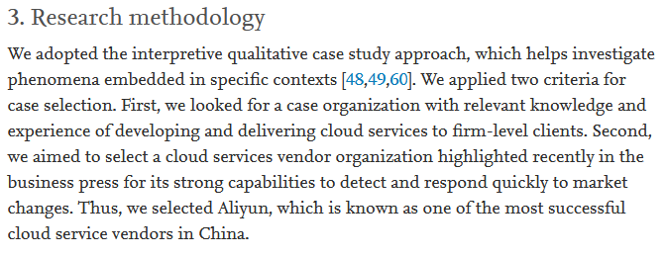
Case selection criteria

Slide 40
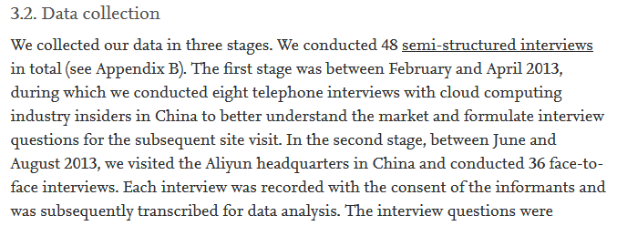
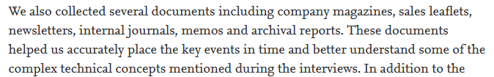
Data collection procedures

Slide 41
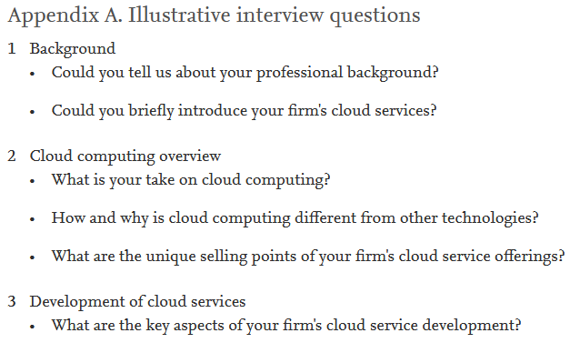
Data collection procedures

Slide 42

Data analysis method

Slide 43

Case study questions

Slide 44
Assignment 4 Setting up a case study protocol
Weekly assignment 4:
Define a research question on the topic of data and business models that can typically be answered using qualitative research
Use that RQ as the basis for this assignment (or come up with another one)
Write down your research question (appropriate for a case study)
Focus on gaining in-depth insights, not on frequencies
How or why question

Slide 45
Assignment 4 Setting up a case study protocol
Assignment:
Imagine you would conduct a case study to answer this RQ
Individually/in pairs think of what information you would put into your case study protocol sections

Slide 46
Assignment 4 Setting up a case study protocol (A)
Section A: an overview of the case study
Objectives
What would be the objective of your case study to answer the research question?

Slide 47
Assignment 4 Setting up a case study protocol (B)
Section B: data collection procedures
Identification of likely sources of data
What data (sources) would you collect if you would conduct a case study to answer your research question?

Slide 48
Assignment 4 Setting up a case study protocol (C)
Section C: protocol questions
The specific questions that the case study researcher must keep in mind in collecting data
What specific questions would you need to keep in mind while conducing a case study to answer your research question?

Slide 49
Assignment 4 Setting up a case study protocol (D)
Section D: a tentative outline for the case study report
Audience for the case study report
For what audience would you publish the case study report?

Slide 50
Next week
Monday: Wrap-up case study + Intro to qualitative analysis
Tuesday: Practice with qualitative analysis

